Slide 1

MINOR PROJECT PRESENTATION
Project Guide :-
Dr Umashankar Rawat
Submited By:–
Dhruv Jhanwar(209301369)
Parth Ratra(209303074)

Slide 2

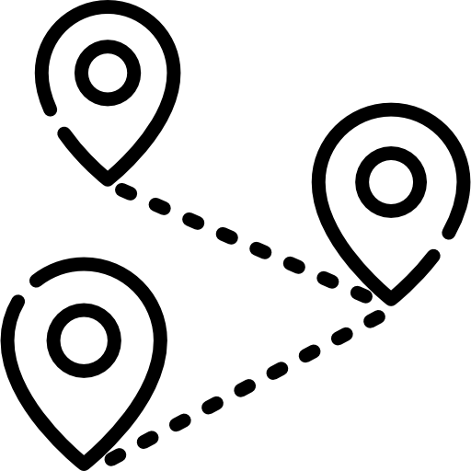
ROWER TAXI
Car Pooling made EASy
Meeting Your destinations

Slide 3


<H1><u> AIM </u></H1>
PROVIDE CHEAP AND FUN TRAVEL TO THE STUDENTS, AND HELP THEM POOL TAXI’S
EASILY~!

Slide 4

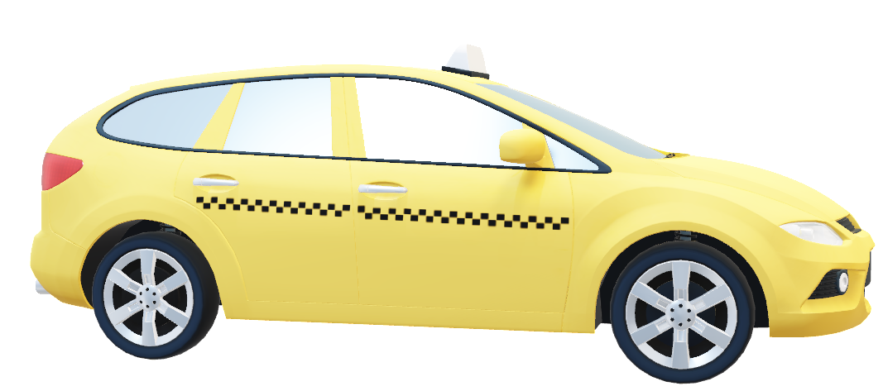
Story behind the idea
Since the day we arrived college we all have faced an issue of travelling in the city because Manipal is situated far away from the Jaipur city, so travelling is always a need to reach out places.
Travelling minimum 30km to reach the heart of the Pink City has always led to empty pockets of students.
People used to pool earlier also but that is not efficient for them, you know the amount of time it takes to find a similar traveler on messaging applications.
Our web application fills this gap between similar travelers and taxi drivers.

Slide 5
FEATURES
1.Cab booking
2.Car pooling
3.Rider Authentication
4.Driver Authentication
5.Sign In/login/logout

Slide 6

1. CAB BOOKING
A rider can book a ride for the place they want to visit from all the drivers available in the driver's database.
Then if the driver confirms the ride, then rider gets the confirmation.
DEPARTURE
DESTINATION
CALANDER
PASSENGERS

Slide 7
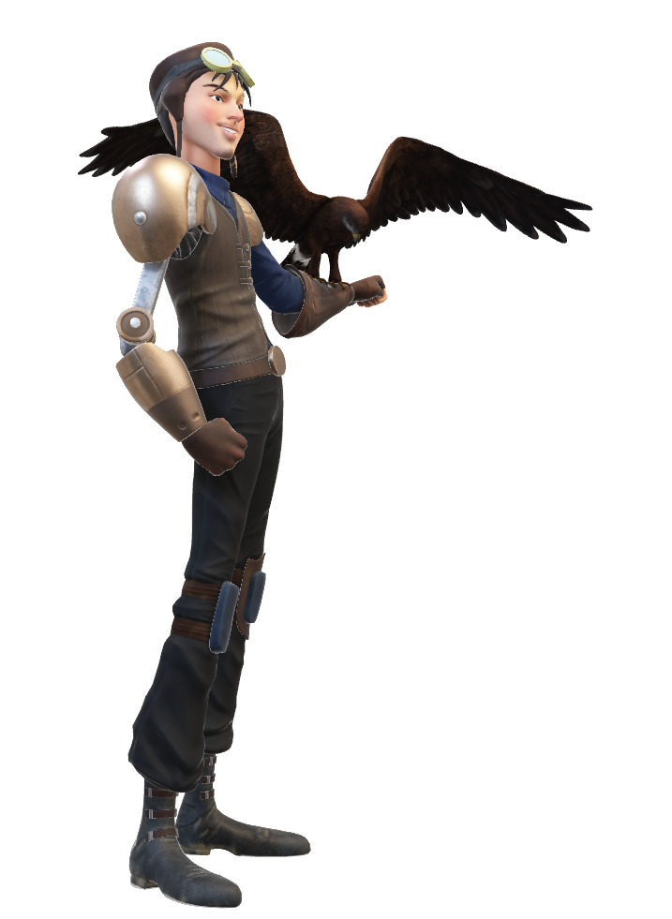
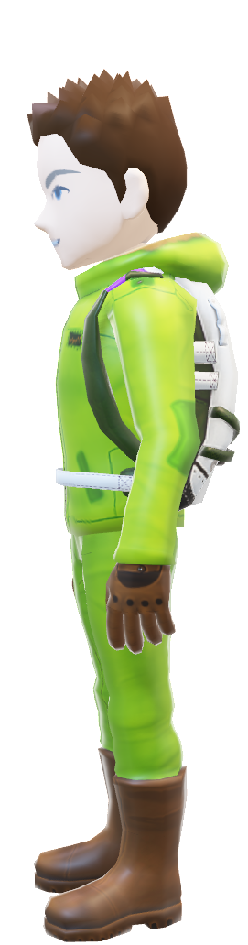
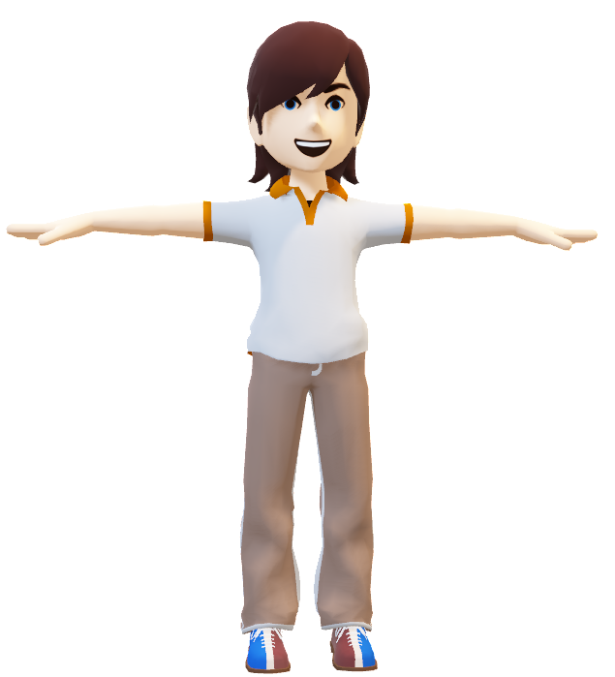
2. Car Pooling
If more than one rider choose the same driver and the driver accepts their request, then they can pool the car.
This will reduce the fair for each person significantly.
₹300
₹300
₹300
₹900

Slide 8

3. Rider authentication
We will authenticate user using Gmail id or phone number.
This way we can define the gentility of a user.
This information is for signing up, after which the user will fill the remaining information.

Slide 9


4. Driver Authentication
On the driver side authentication, we get the drivers details.
Name, car-details, Aadhar, License of the driver , Car RC.
Driver’s photograph should be uploaded to verify the driver’s profile.

Slide 10


5. Login/Signup/logout
The user can signup using Gmail id.
The user can signup using mobile OTP verification.
This data will reach the firebase database.
We will be fetching all the driver details to rider interface from the driver’s database.
We will be fetching all the rider’s details to driver interface from the rider’s database.

Slide 11






Technology USEd
GIT
FIREBASE

Slide 12
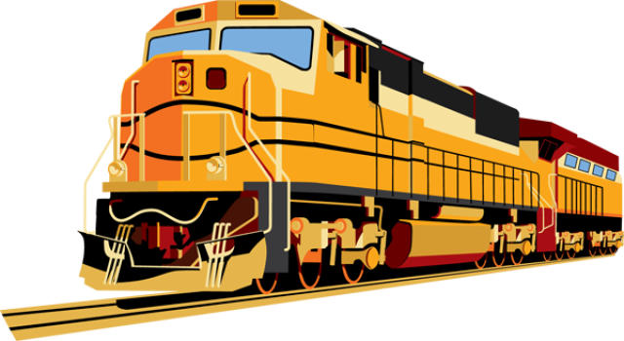

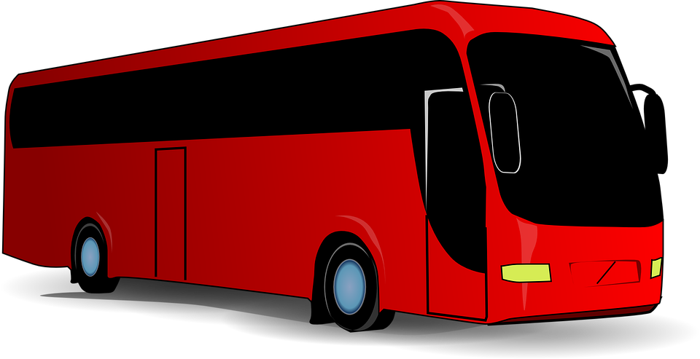

Future prospects
Initially we will have trips limited to certain places in Jaipur which are most visited by students. Later we will integrate a larger map:-
Railway Station
Airport
Bus Stand

Slide 13


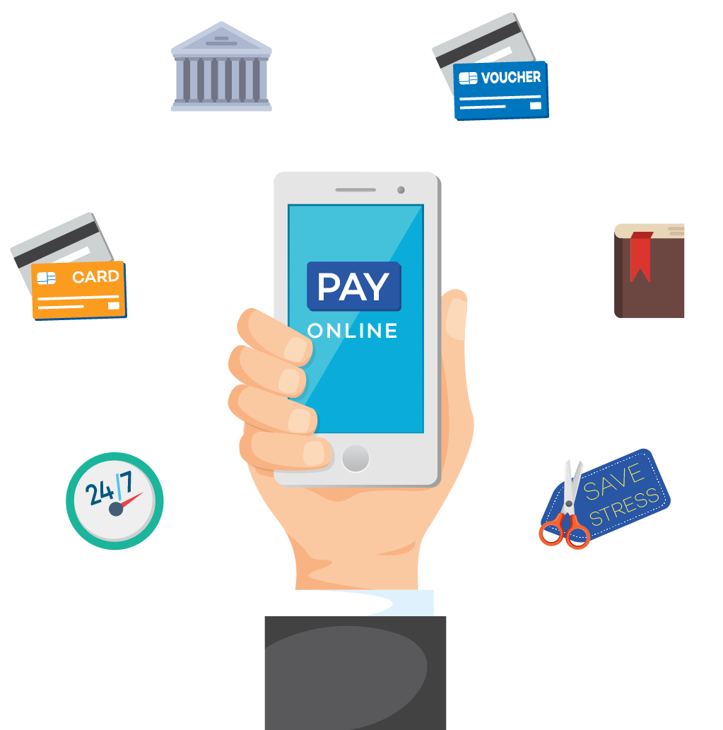
FUTure prospects
Aadhar and Driving license API authentication through surpass technologies.
Hosting it and getting SSL certificate for live usage.
Payment gateway for payments through our site.

Slide 14
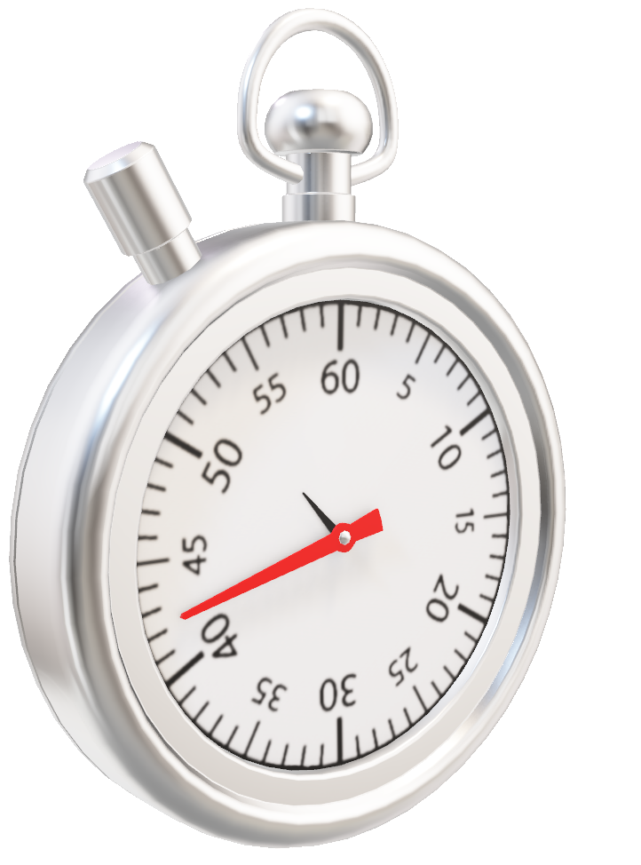
HOPE TO SEE YOU SOON IN ROWER THE NEXT TIME YOU TRAVEL

Slide 15

THANKYOU

